Slide 1

Convolutional neural networks in scanning probe microscopy
Sham Ayrouta & Valdemar Lund-Frank
University of Copenhagen
Advanced Methods in Applied Statistics

Slide 2
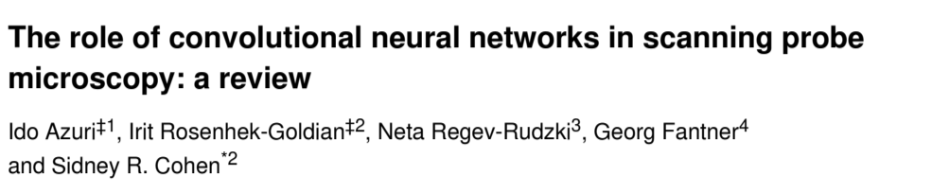
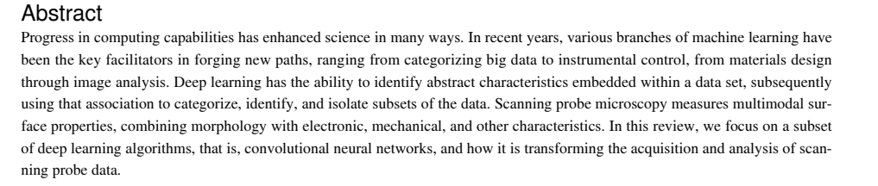
The problem
To produce high resolution images using SPM:
Time consuming process
Large amount of data
Difficult to distinguish relevant features without advanced image processing techniques and expert judgment

Slide 3
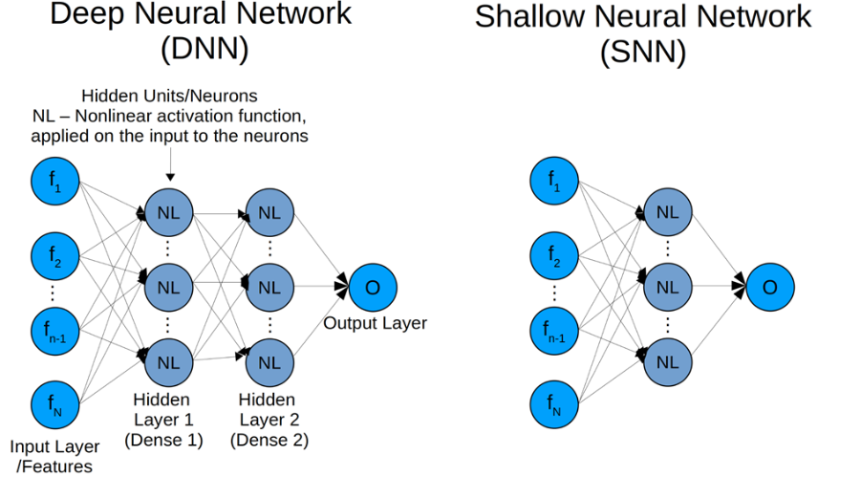
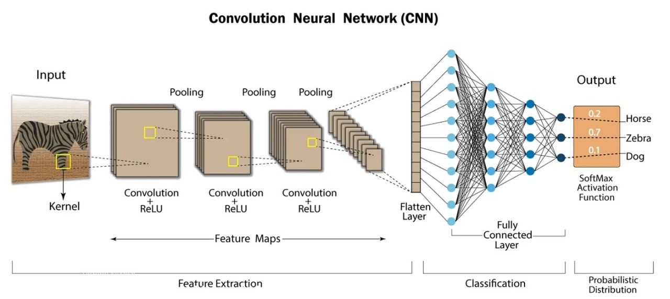
Background knowledge
Machine learning
Neural network
→ Deep learning
→ Convolutional neural network
Credit: Kh. Nafizul Haque

Slide 4
Fundamentals for convolutional neural network
Convolutional Layer
Applies filters to images, producing feature maps.
Filter parameters are optimized during training.
Activation Layer
Introduces nonlinearity to the feature maps.
Enables the network to learn complex decision boundaries.
Pooling Layer
Down-samples feature maps to reduce spatial dimensions.
Retains the most important features.
Operation Block
Hidden layer
Flatten Layer
Converts multidimensional feature maps into a one-dimensional vector.
Prepares data for the dense (fully connected) layer.
2
Loss Function
Measures the error between predictions and true labels.
Guides the optimization process during training.
Classification
Output layer

Slide 5
How CNN is applied in SPM
Two image sets obtained with HS-AFM (high speed atomic microscope)
Corresponds to two experiments (different days, blood donors, slightly different procedure)
First image set: 60 healthy and 65 Pf-EV exposed cells
Second image set: 51 healthy and 58 Pf-EV exposed cells
Images were acquired with 512 × 512 pixels resolution
By applying CNN:
99.0% and 96.6% accuracy on dataset 1 and 2
Combined datasets gave lower accuracy 86.1%
SPM experts average accuracy of 75%

Slide 6
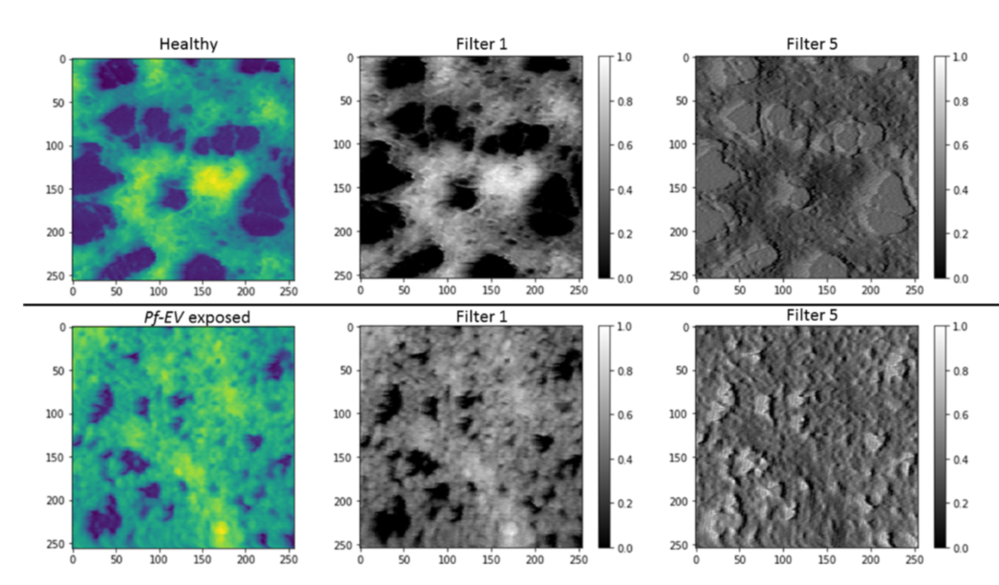
How CNN is applied in SPM
Data set 1
Filter 1 shows more backbone for exposed
Filter 5 shows larger holes for healthy/treated

Slide 7
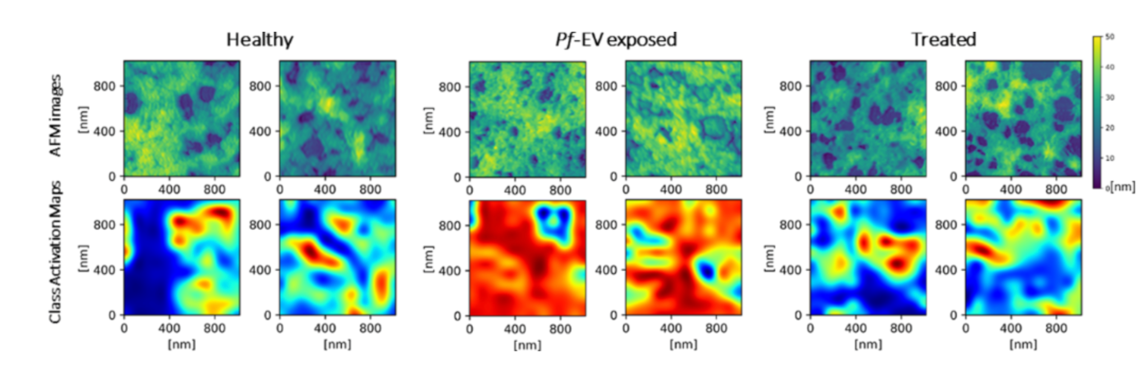
How CNN is applied in SPM
Data set 1 (Bortozomib)
Class activation map
Healthy/treated is distinguished by holes
Exposed is determined by backbone
Notes:
proteasome inhibitor Bortozomib. Inhibit cell growth and cell function

Slide 8
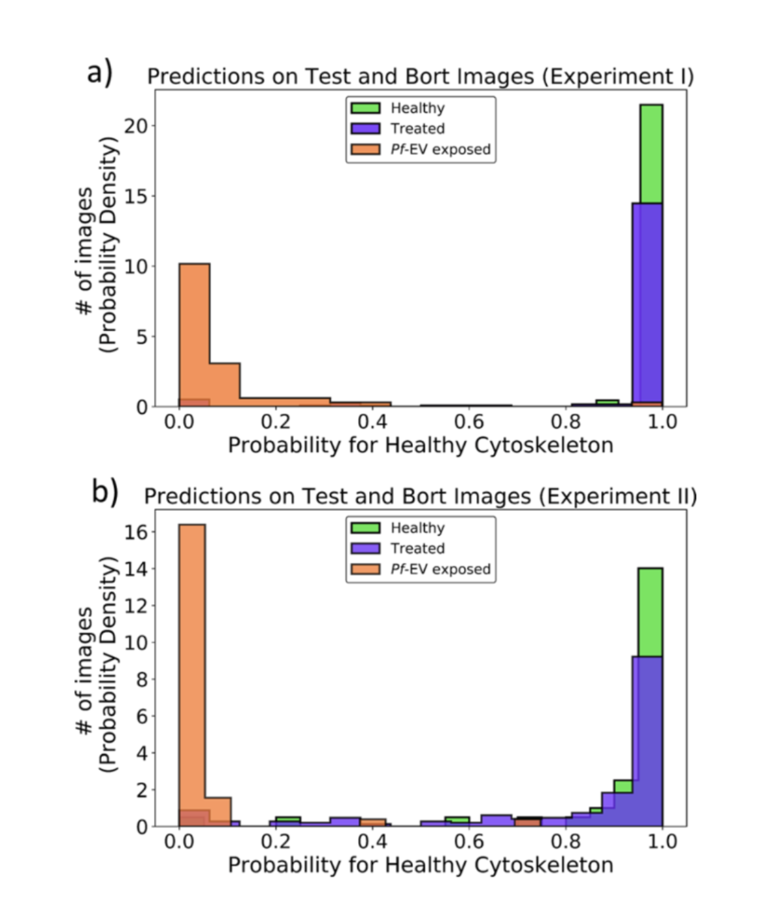
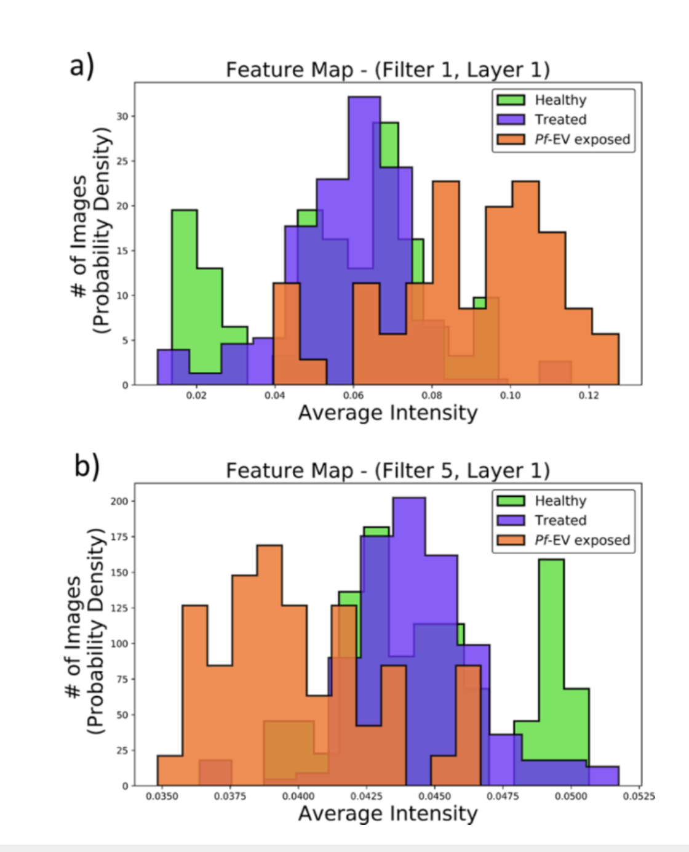
Backbone intensity
Holes intensity

Slide 9
Conclusion
Pros
CNN is usable for SPM and classification of images
High accuracy
Can aid data gathering and analysis
New hypothesis from handling large complex datasets
CNN is applicable for SPM
Cons
Best with large amount of data
Need manual setup and input

Slide 10
Additional materiale

Slide 11
Number from input image
Determined by resolution and color channels of original image.
CNN require standard size (e.g., 224×224 or 32×32) to fit matrix

Slide 12
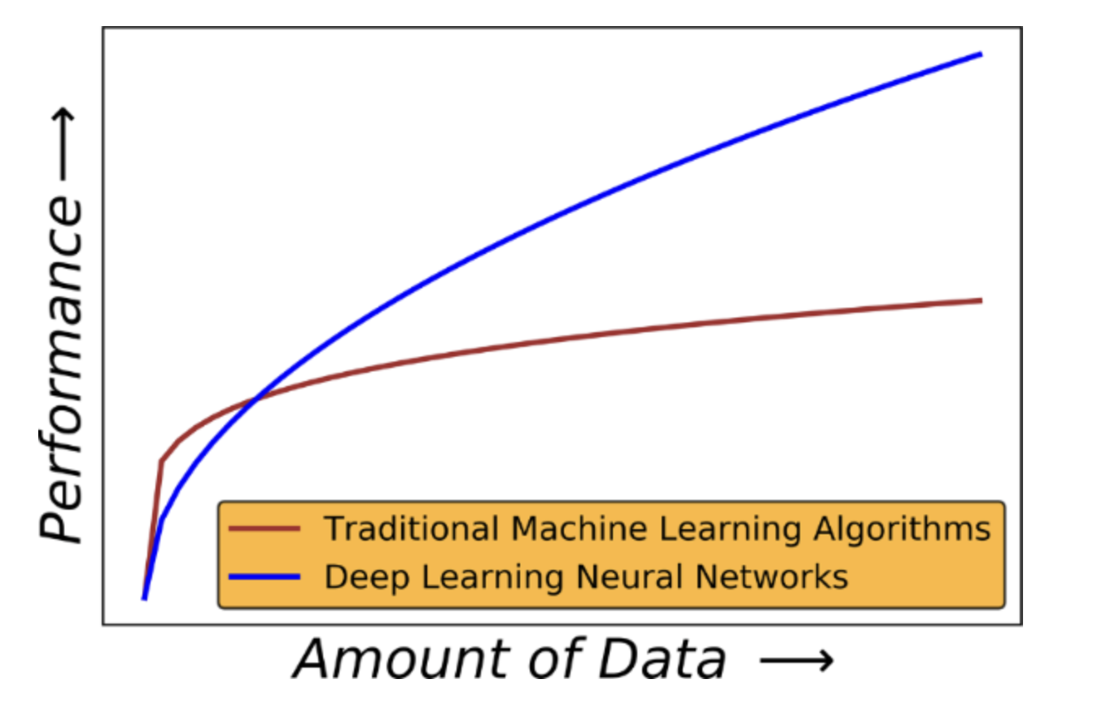

Slide 13
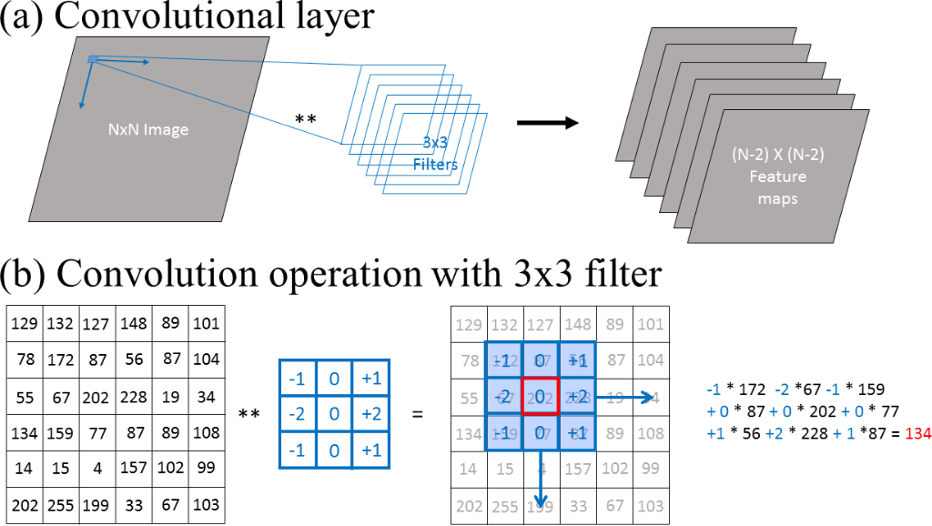

Slide 14
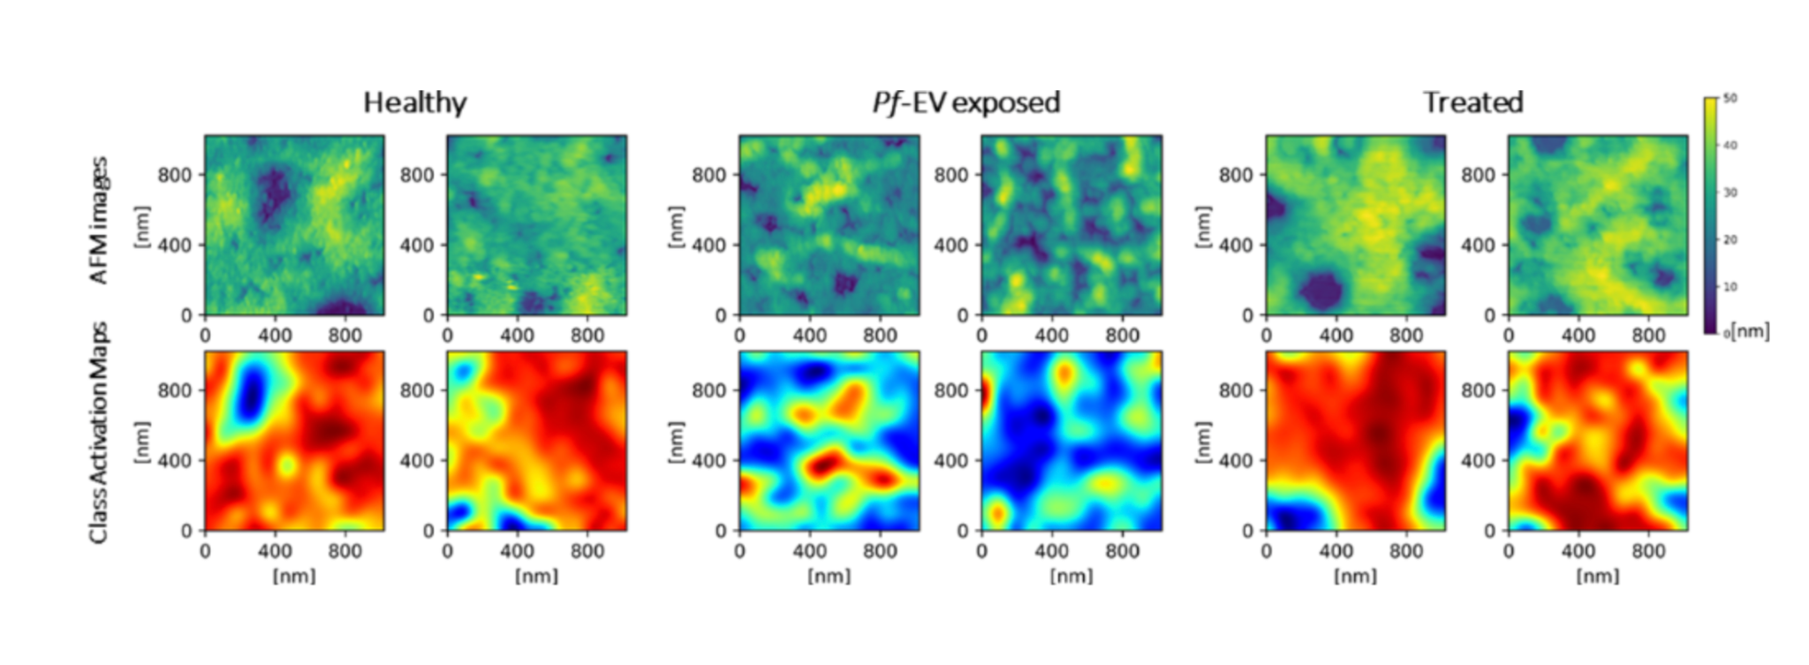
Dataset 2 (Bortozomib)
Class activation map
red is backbone
Healthy/treated larger area of backbone

Slide 15
Random forest modeling (combines the output of multiple decision trees to reach a single result)
Accuracy of 86.0% on dataset 1 and 67.0% on dataset 2
Dataset with Bortozomib-treated samples
94.1% of the 188 images in batch 1 and 86.0% of the 236 images in batch 2 to be healthy.

Slide 16
